Slide 1
Paycheck Protection Program Forgiveness Update
The loan forgiveness program is STILL a work in progress by the SBA and U.S. Treasury.
Information provided is subject to will most likely change.
Romeo Chicco, CPA
PayMaster, Inc.
These slides are for discussion purposes only. Distribution only with permission from Romeo Chicco.
Notes:
9th version!
STILL - this presentation is meant to be an important update and I will not be able to get to all questions. I will also not review the basics, such as what the funds can be spent on. For most, it is too late.

Slide 2
Forgiveness Process Is Open
As of August 10th, the SBA is now accepting forgiveness applications via your lender.
Your lender may still not be ready to accept the application from you.
There is NO RUSH?*
Deferral until 10 months after the end of your “covered period.”
Deadline is 2 or 5 years from the loan execution. (loan docs)

Slide 3
Covered Period
The eight-week/24-week period begins on the date the lender makes the first disbursement of the PPP loan to the borrower.
Received funds Thursday, April 30th
Spending deadline, October 14th
Count 55/167 days starting the day after the funds are deposited into your account.

Slide 4
Covered Period
Loans on or before June 5, 2020 8 weeks with 24 week option
Loans after June 5, 2020 will be shorter of 24 weeks or until December 31, 2020
You can designate a covered period that is less when you file for forgiveness

Slide 5
Sale/Transfer of Business/Assets
Greater than 50%
SBA Approval Required – Yes
Lender Approval Required – Yes
Escrow Required – Yes, to avoid wait for SBA approval
Documentation Required
Reason for requiring approval
Details of pending sale/transfer
Copy of PPP loan note
Letter of intent and sale/transfer agreement
Disclosure of buyers PPP loan status
List of all greater than 20% owners

Slide 6
Wage Limit For Forgiveness - Employees
The exclusion of compensation in excess of $100,000 annually applies only to cash compensation, not to non-cash benefits.
The maximum is $15,385 (8-week) or $46,154 (24-week) for non-owners.

Slide 7
Wage Limit For Forgiveness - Owners
The amount paid to owners, general partners, or self-employed individuals is capped at the lesser of;
$15,385 (the eight-week equivalent of $100,000), or
the eight-week equivalent (15.385%) of their compensation for 2019.
OR
$20,833 if using the 24-week covered period.
Limit is across ALL businesses owned in PPP forgiveness

Slide 8
Forgiveness
Apply through the issuing lender
Lender will have up to 60 days to issue a decision
All loans in excess of $2 million and ‘other loans as appropriate’ will be reviewed (aka Audit) by SBA/Treasury***
SIX year record retention period!
EIDL Advance reduces forgiveness amount
Pick your forgiveness application form
3508
3508EZ
3508S

Slide 9
3508 S (S=super simple & short)
Automatic forgiveness?
Loan amounts of $50,000 or less (represents about 67% of all loans)
Affiliation rules apply if PPP loans total $2 million or more, form cannot be used
Exempt from FTE reduction penalty
Exempt from the Salary and Wage reduction penalty
No math involved on form
Still required to spend PPP funds appropriately

Slide 10
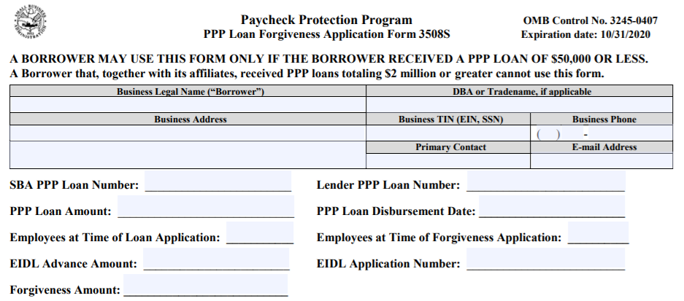

Slide 11
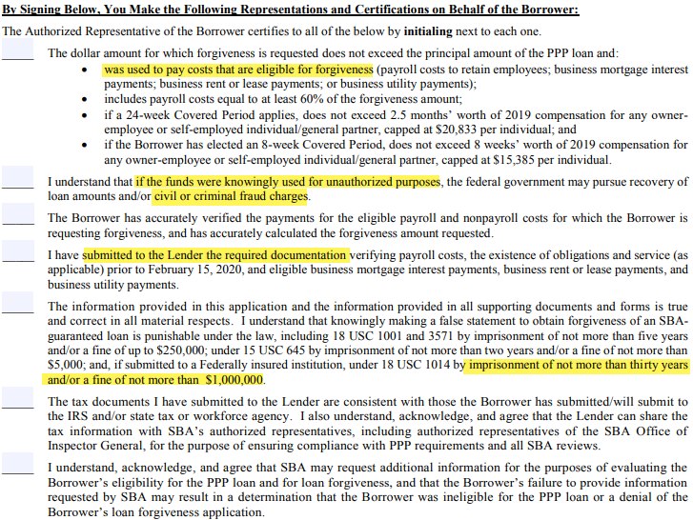

Slide 12
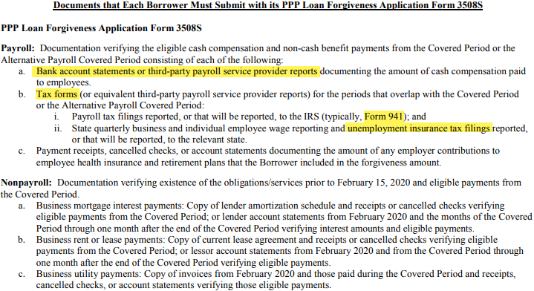
Documentation

Slide 13
3508 EZ
Borrower did not reduce any salary or hourly rate by more than 25% during the covered period compared to 1st quarter
AND
1. borrower did not reduce the number of employees or the average paid hours of employees during the covered period* OR
2. borrower was unable to operate during the covered period at the same level of business activity as before February 15, 2020, due to compliance with requirements established or guidance issued by CDC or OSHA.

Slide 14
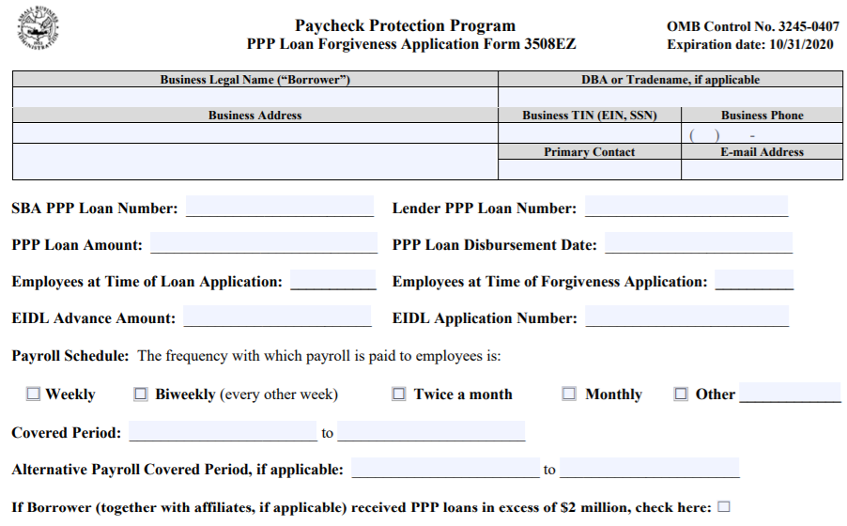

Slide 15
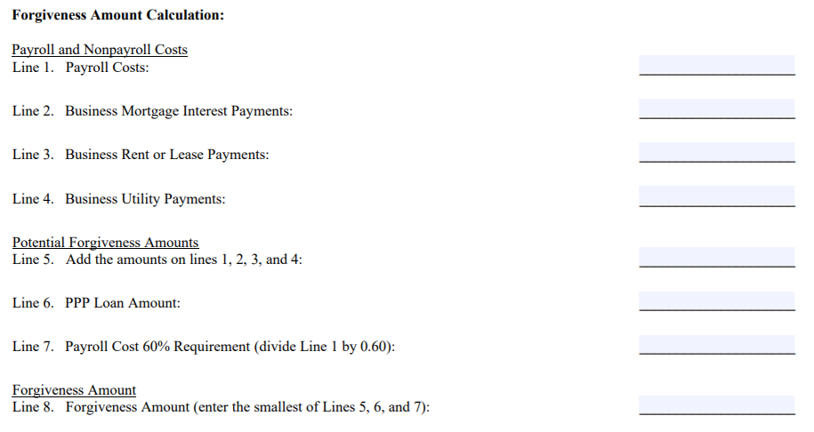

Slide 16
3508

Slide 17
*** PPP Forgiveness $2M +
NEW as of 10/28/2020!
Must demonstrate ‘Loan Necessity’ by completion of either the 3509 Form or the 3510 Form for non-profits.
Remember why Ruth’s Chris, Shake Shack, and many other large companies returned their PPP funds early in the process?
The SBA is using the 9 pages of questions to determine if the business really needed the funds and had no other means of liquidity.
blog.paymaster.com
Notes:
LA Lakers $4.6m, AutoNation $77m,
Revenue pre/post PPP, HCEs >$250,000, March 31 bank balance.

Slide 18
The IRS
Forgiven debt is normally taxable, but PPP loan will be excluded.
BUT…
On April 30, the IRS Ruled out tax deductions for wages and rent paid with forgivable PPP loans. (Notice 2020-32)
* Decision – Debt forgiven prior to end of the year or next year?
Notes:
No Double Benefit.

Slide 19
blog.paymaster.com

Slide 20
